Slide 1

Compiling historical TRAFFIC data to power breakthrough insights

Slide 2
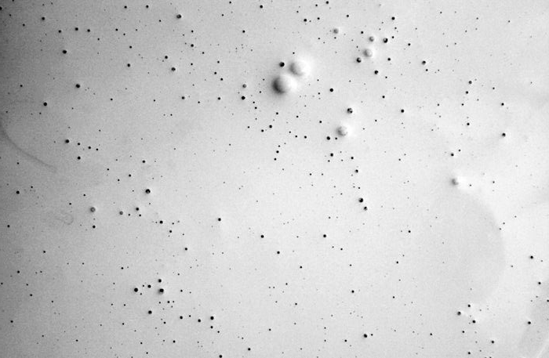
STATEMENT OF THE PROBLEM
Accurate and reliable transportation data is critical for monitoring the performance of a transportation system, identifying problems, and making informed planning decisions. However, data for transportation planning is traditionally difficult to find, expensive to collect, and limited to specific locations and time periods depending on needs. The increasing road traffic congestion have had growing negative effects on business operations and on people. Therefore, this study intends to assist people in travel such as to determine likely travel times.

Slide 3
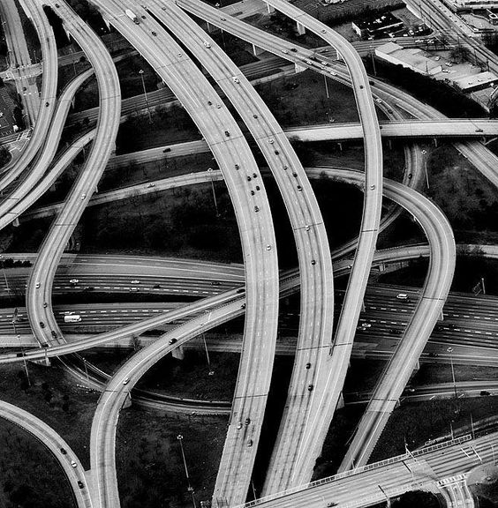
PURPOSE AND DESCRIPTION
It is constantly helpful to further improve previous methods which were in some cases developed based on relatively poor information of traffic conditions. Therefore, the purpose of this paper is to understand travel conditions throughout the metropolitan areas when responding to needs and planning for the future which can effectively enhance mobility.

Slide 4
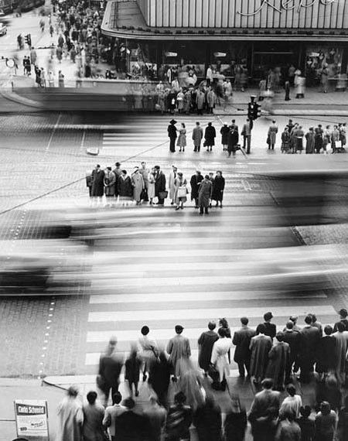
Retrieve traffic data to gain performance insights and understand patterns of behavior of traffic
OBJECTIVES

Slide 5

SCOPE AND LIMITATIONS
This study will cover the traffic network for point “A” to point “B” location in Makati City, which will revolve around the people who resides, go to work, shop and do business. The gathered datasets will come from Uber Movement.

Slide 6

Related literature

Slide 7

‘Utilizing Real-World Transportation Data for Accurate Traffic Prediction’
- Pan, Demiryurek and Shahbi
‘Predicting Expected Road Traffic Conditions based on Historical and Current Data’
- Scofield, Cahn, Hersch, Stoppler, Yakich, Huang & Barker
‘Using Location Data to Determine Traffic and Route Information’
- Nagda, Li, Howlett, Fan, Yang, Fay
‘Representative Road Traffic Flow Information based on Historical Data’
- B. Downs, S. Hersch, C. Chapman

Slide 8

TECHNICAL BACKGROUND

Slide 9

Data Collection
Android Studio
Java
Firebase

Slide 10

REQUIREMENT ANALYSIS
Quantitative Approach where the emphasis is on collecting and analyzing numerical data

Slide 11

DATA GATHERING PROCEDURE

Slide 12
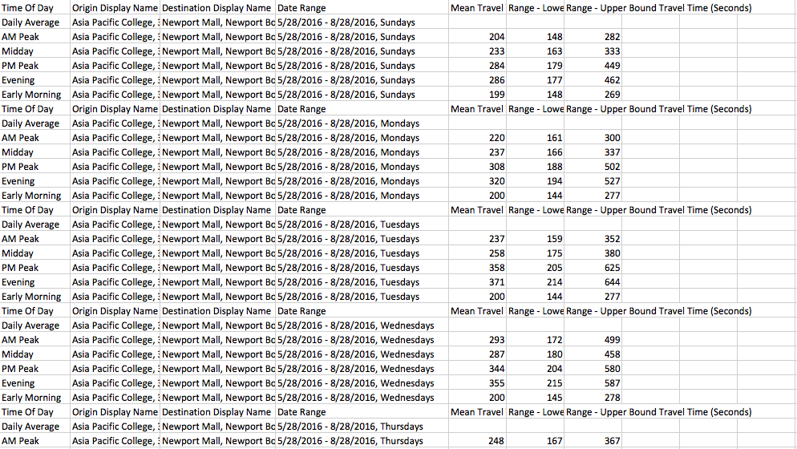

Slide 13
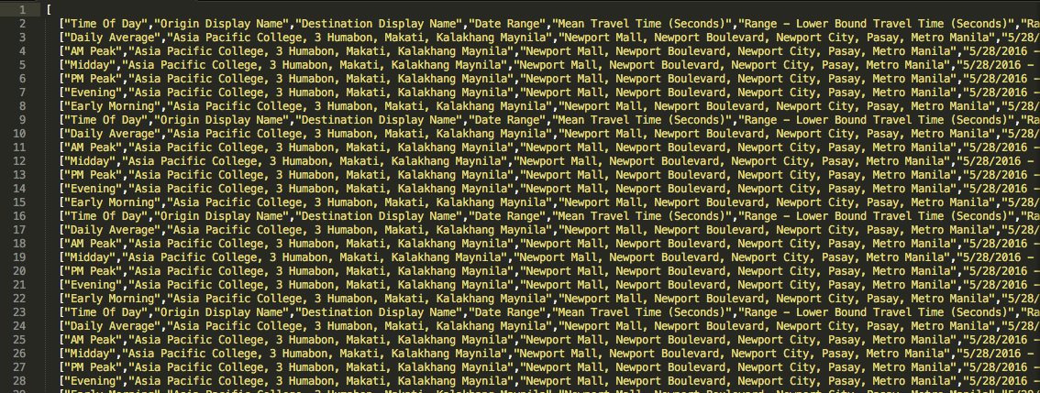

Slide 14
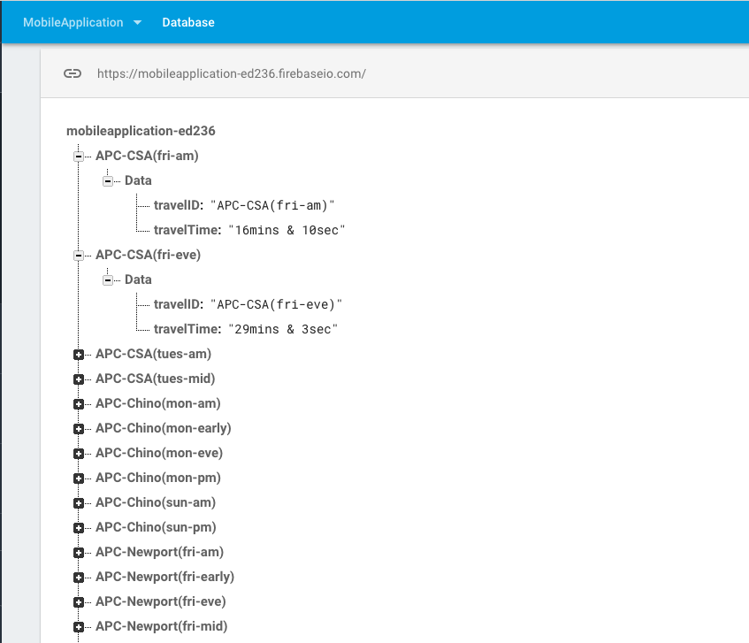

Slide 15
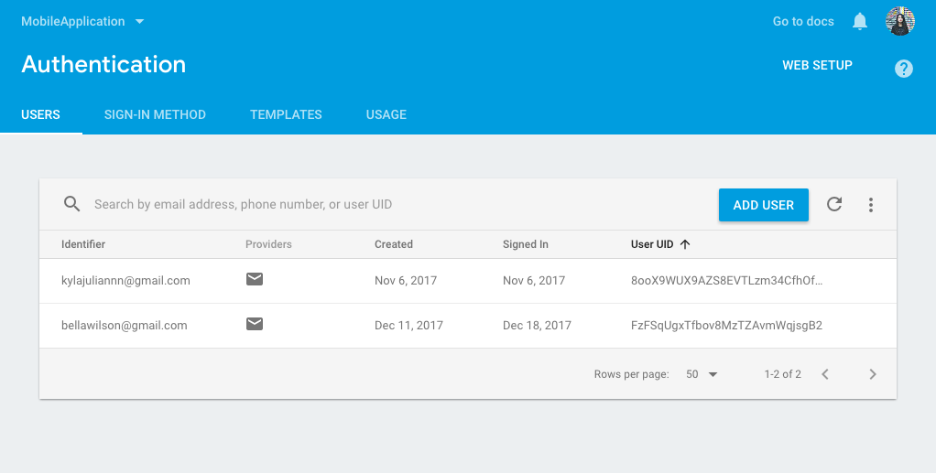

Slide 16
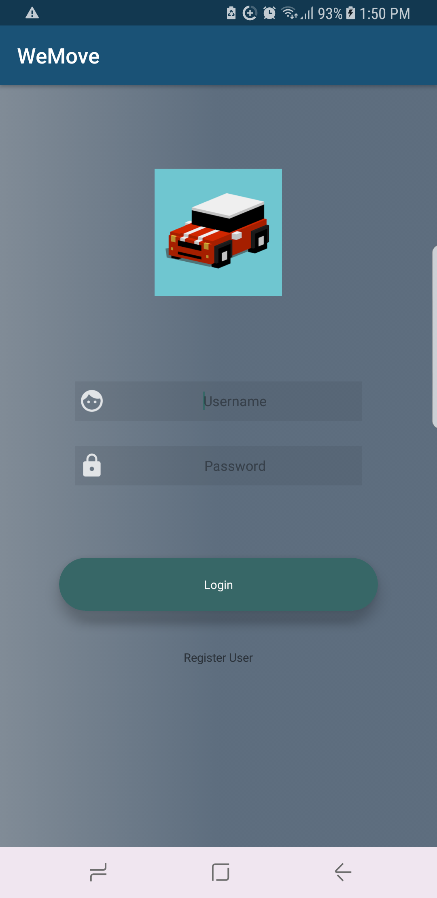
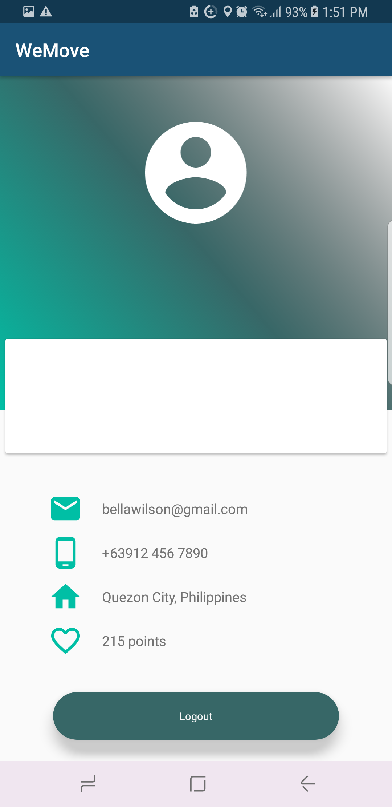
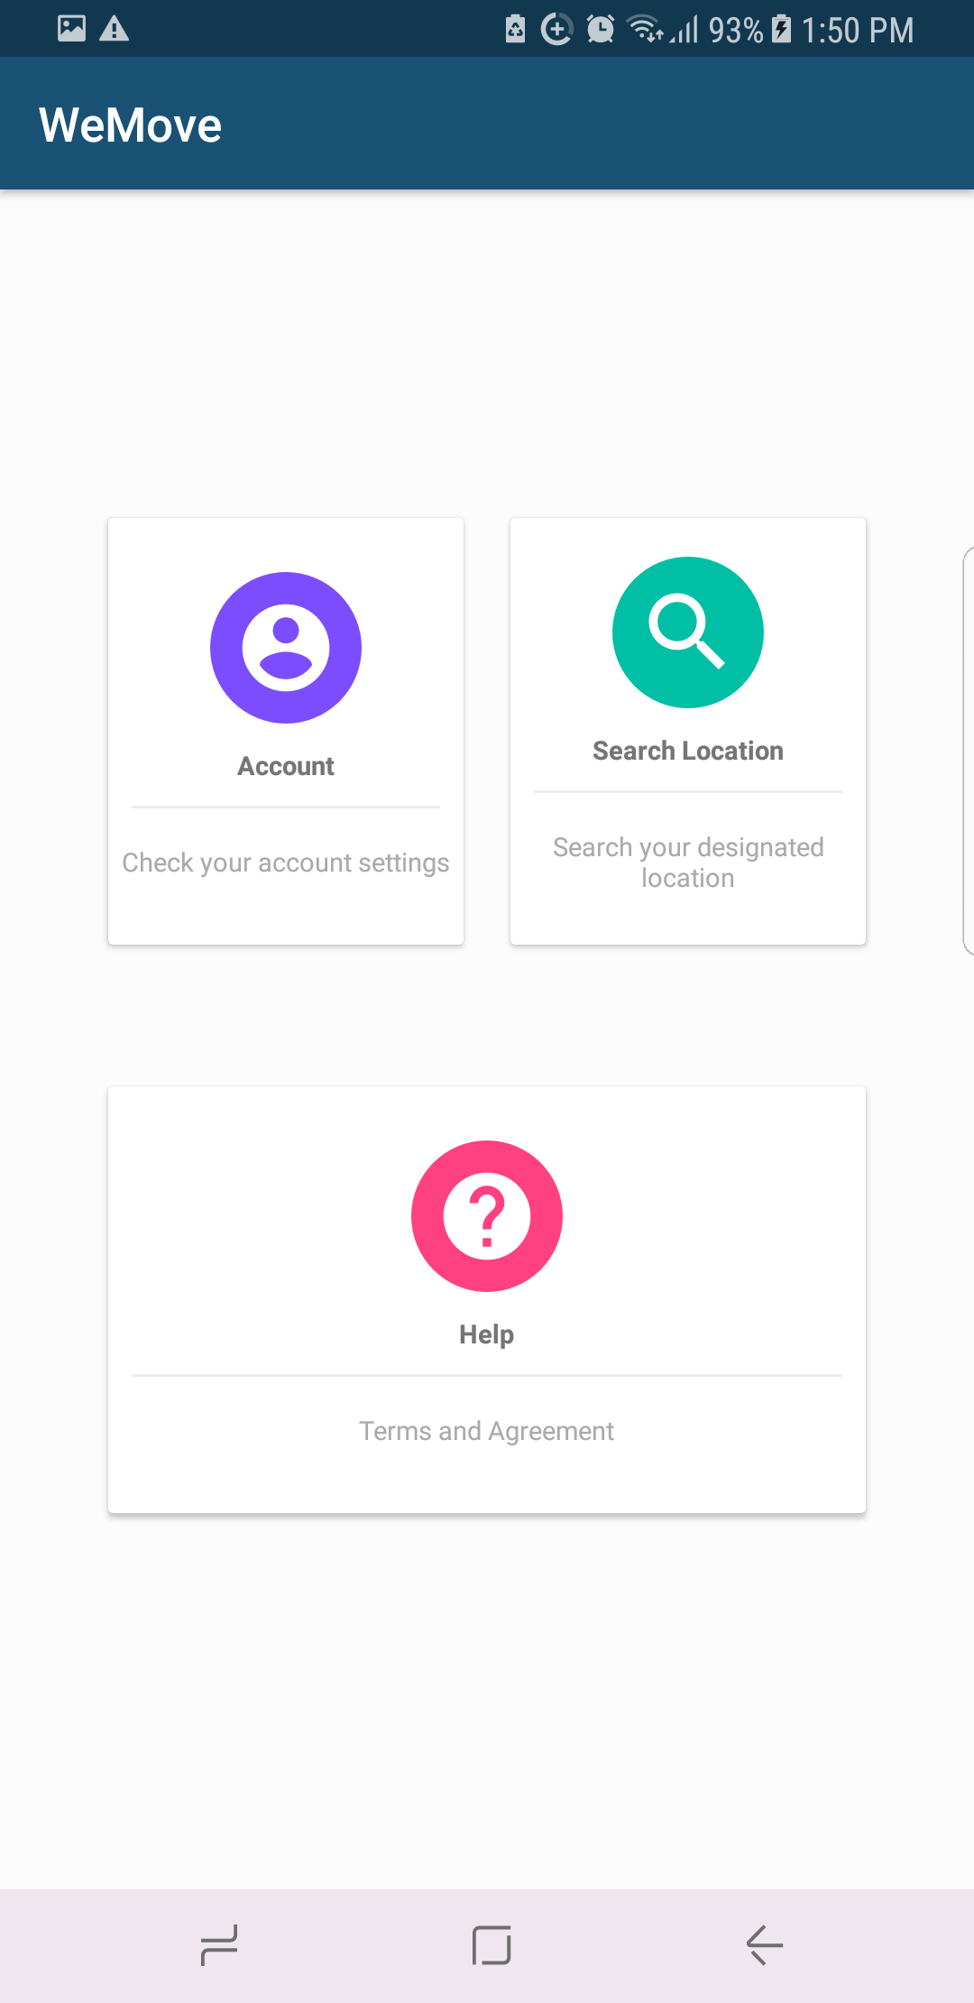

Slide 17
